Slide 1
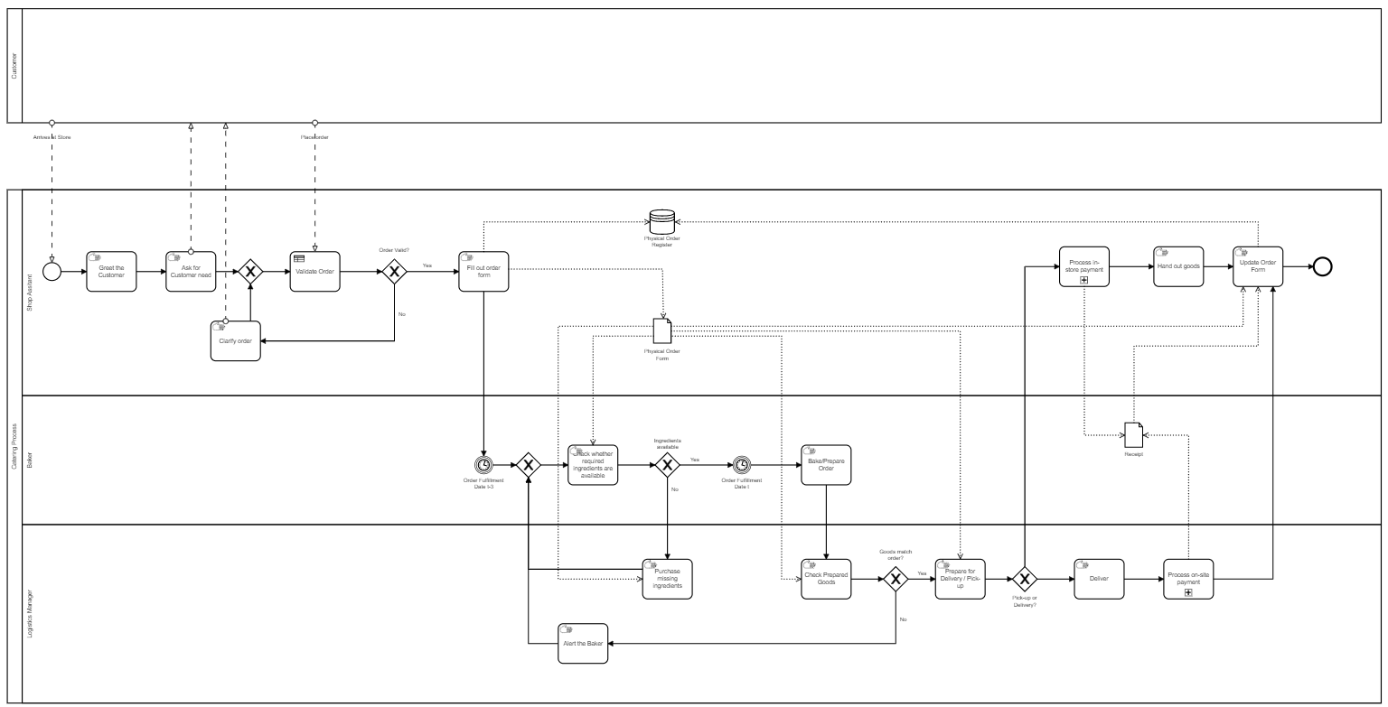
Potential to be changed in the digitalised/made obsolete process

